Slide 1
Java Web Security

Slide 2
Security for Java EE web applications can be implemented majorly in two ways:
Declarative security: Can be implemented using either metadata annotations or an application’s deployment descriptor.

Slide 3
Programmatic security: Is embedded in an application and can be used to make security decisions when declarative security alone is not sufficient to express the security model of an application. Declarative security alone may not be sufficient when conditional login in a particular work flow, instead of for all cases, is required in the middle of an application

Slide 4
Concepts of Servlet Security
The four main concepts of security are Authentication
Authorization
Confidentiality
Data Integrity

Slide 5
Authentication is the process by which users' access privileges are verified prior to their entering a Website's protected area.
Authorization is the process of defining access policies for the resources we wish to protect. It is the way to ensure that the user has the rights to enter into the restricted area or perform a specific restricted function. In case of a Web application, it is the process of verifying the user’s rights based on his predefined role to access any restricted resource on the system.

Slide 6
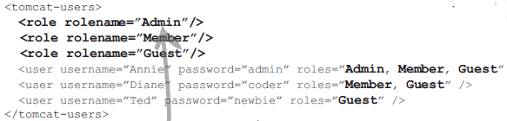
Steps for Authorization
tomcat-users.xml ( vendor-specific)

Slide 7
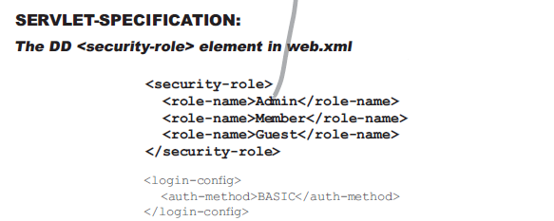

Slide 8
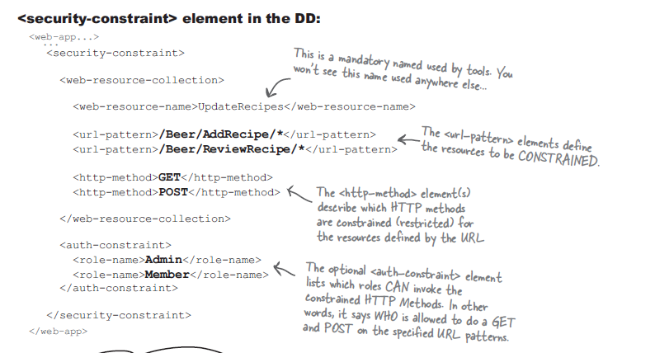
Step 2 Authorization

Slide 9
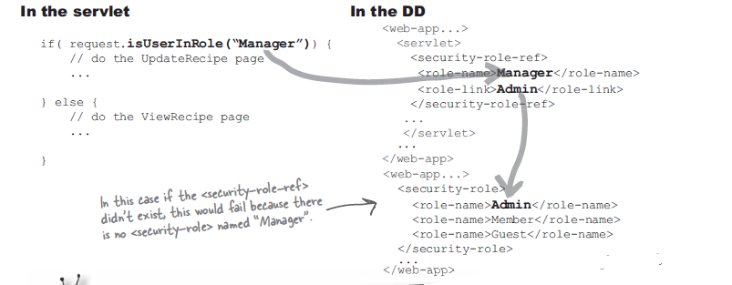

Slide 10
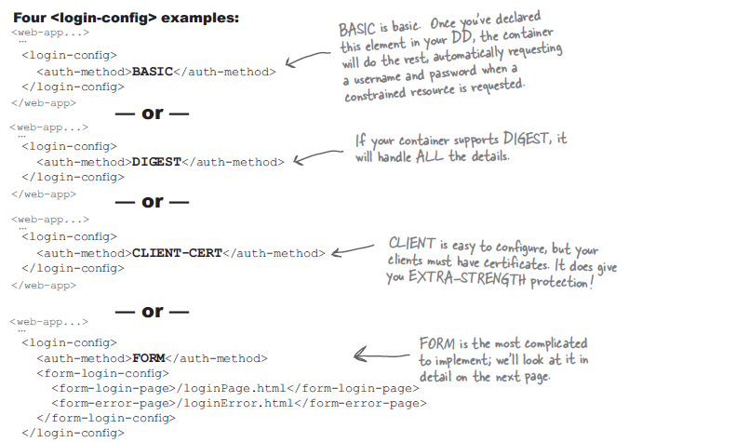
Authentication Types

Slide 11

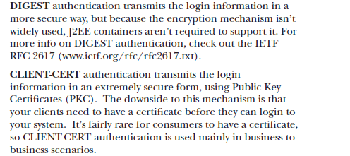

Slide 12

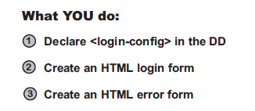

Slide 13
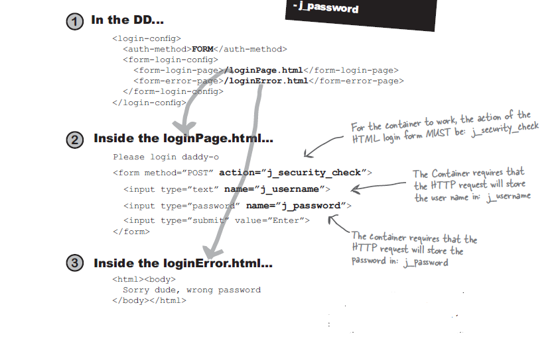

Slide 14
